Slide 1
Finding ACS & Decennial Data
David Kraiker, US Census Bureau
Ct Leg Libraries
2024-06-11

Slide 2
“Current” Surveys
HUD: American Housing Survey
NYC: Housing Vacancy Survey: NYC
US Dept Labor: Consumer Expenditure,
Current Population Survey
US Dept of Justice: Nat’l Crime & Vicitimization Survey
CDC: Nat’l Health Interview, Nat’l Ambulatory Medical Cure Survey; Nat’l Hospital
Census Bureau: Survey of Income & Program Participation (SIPP);
American Community Survey (ACS)

Slide 3
2020 Census
ACS
100 % Data
Sample Data
How do people live in the U.S.?
How many people live in the U.S.?
Period in Time 2 Mos.
Point in time April 1, 2020
Characteristics Income, Poverty, Education, Housing
Count - People, Housing units,
Notes:
When?
Spring 2023
Where?
Hosted by the Census Academy in collaboration with COIL, using one of the proposed tools listed in the section “Resources Needed”.
Invitation:
Stage 1 - 9/6/22: Send save-the date email to Census Bureau subscribers.
Stage 2 - 9/13/22: Send an invitation to register to Census Academy and COIL subscribers only.
Stage 3 - 9/20/22: Send an invitation to register to all Census Bureau subscribers.
Stage 4 - 10/4/22: Send a reminder to register to all subscribers.
Stage 5 - 10/17/22: Send final reminder to register and attend event.

Slide 4
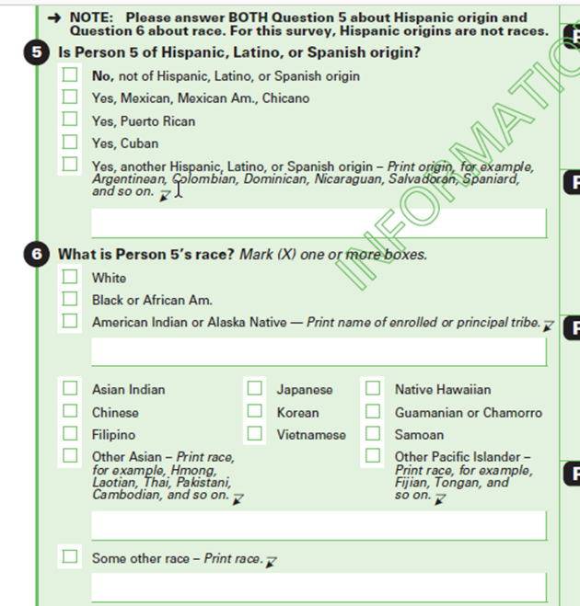
American Community Survey
Annual sample size of 3.5 mil addresses
Data collected impartially by mail, online or in-person
Geographic levels: Nation to Block Group; PUMAs; Tract!
Data released yearly (1- and 5-year data)

Slide 5
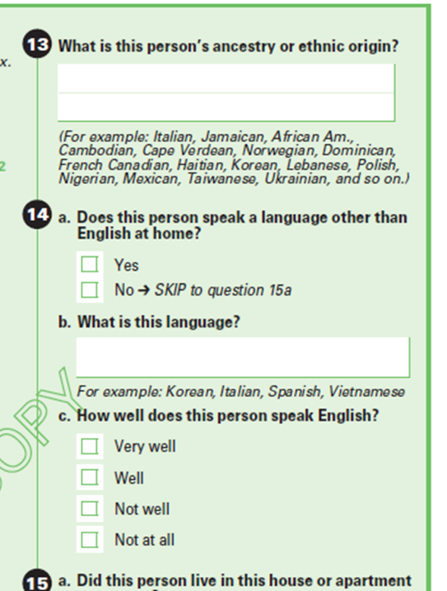
American Community Survey
About 72 Questions
“Deep” Characteristics
Name?
In tables, refer to: “B-, C-, S-, and DP” id’s
Tract-level availability

Slide 6
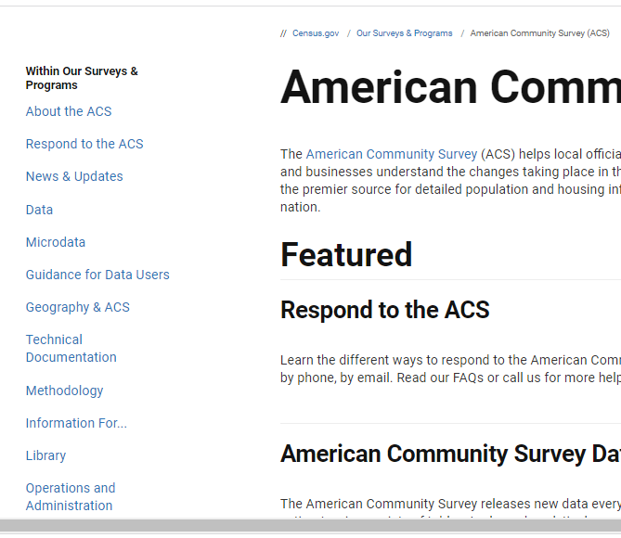
The ACS has its own site:
www.census.gov/acs

Slide 7
What Topics Are Available in the ACS?
Social (DP02)
Demographic (DP05)
Economic (DP03)
Housing (DP04)
Ancestry
Citizenship Status
Disability Status
Educational Attainment & School Enrollment
Fertility
Grandparents as Caregivers
Language Spoken at Home
Marital History; Marital Status
Migration/Residence 1 Year Ago
Period of Military Service
Place of Birth
Undergraduate Field of Degree
Veteran Status
Year of Entry
Age
Race
Hispanic Origin
Sex
Income
Benefits
Employment Status
Occupation
Industry
Commuting to Work
Place of Work
Tenure
Housing Value
Occupancy
Taxes and Insurance
Household Size
Utilities
Notes:
Pictured here are all of the topics available from the ACS. In the small orange box are the topics available from the decennial census. I think we all can agree that we want to use the ACS data as opposed to the decennial census data, right?
This slide shows the different topics covered by the American Community Survey, organized under four different categories: Demographic, Social, Housing and Economic Characteristics. We have Data Profiles for each of these four general categories, which are a great place to start for individuals that want to better understand their local communities and for those individuals that are not familiar with our data.
Looking at the Demographic Characteristics, you are able to get data for Age, Sex, Race and Hispanic Origin. Note that these topics are also covered in the 2020 Census. Census data becomes outdated with the passing years in the decade, the ACS will provide updated estimates on these key demographics.
The Social Characteristics category has the greatest number of topics, including Educational Attainment, Language Spoken at Home and Marital Status.
The Housing Characteristics topics allows you to better understand the housing stock as well as the affordability of a community – how much people spend on rent/mortgage as a percentage of their income.
And, the Economic Characteristics topics include Income, Employment and Occupation among other topics.
This slide shows the different topics covered by the American Community Survey, organized under four different categories: Demographic, Social, Housing and Economic Characteristics. We have Data Profiles for each of these four general categories, which are a great place to start for individuals that want to better understand their local communities and for those individuals that are not familiar with our data.
Looking at the Demographic Characteristics, you are able to get data for Age, Sex, Race and Hispanic Origin. Note that these topics are also covered in the 2020 Census. Census data becomes outdated with the passing years in the decade, the ACS will provide updated estimates on these key demographics.
The Social Characteristics category has the greatest number of topics, including Educational Attainment, Language Spoken at Home and Marital Status.
The Housing Characteristics topics allows you to better understand the housing stock as well as the affordability of a community – how much people spend on rent/mortgage as a percentage of their income.
And, the Economic Characteristics topics include Income, Employment and Occupation among other topics.
This slide shows the different topics covered by the American Community Survey, organized under four different categories: Demographic, Social, Housing and Economic Characteristics. We have Data Profiles for each of these four general categories, which are a great place to start for individuals that want to better understand their local communities and for those individuals that are not familiar with our data.
Looking at the Demographic Characteristics, you are able to get data for Age, Sex, Race and Hispanic Origin. Note that these topics are also covered in the 2020 Census. Census data becomes outdated with the passing years in the decade, the ACS will provide updated estimates on these key demographics.
The Social Characteristics category has the greatest number of topics, including Educational Attainment, Language Spoken at Home and Marital Status.
The Housing Characteristics topics allows you to better understand the housing stock as well as the affordability of a community – how much people spend on rent/mortgage as a percentage of their income.
And, the Economic Characteristics topics include Income, Employment and Occupation among other topics.

Slide 8
What Topics Are Available in the ACS vs. Decennial Census?
Social (DP02)
Demographic (DP05)
Economic (DP03)
Housing (DP04)
Ancestry
Citizenship Status
Disability Status
Educational Attainment & School Enrollment
Fertility
Grandparents as Caregivers
Language Spoken at Home
Marital History; Marital Status
Migration/Residence 1 Year Ago
Period of Military Service
Place of Birth
Undergraduate Field of Degree
Veteran Status
Year of Entry
Age
Race
Hispanic Origin
Sex
Income
Benefits
Employment Status
Occupation
Industry
Commuting to Work
Place of Work
Tenure
Housing Value
Occupancy
Taxes and Insurance
Household Size
Utilities
What topics can you get from the 2020 Census?
Age
Race
Sex
Hispanic or Latino Origin
Household Relationship
Tenure (Owned vs. Rented
Vacancy Characteristics
Notes:
Pictured here are all of the topics available from the ACS. In the small orange box are the topics available from the decennial census. I think we all can agree that we want to use the ACS data as opposed to the decennial census data, right?
This slide shows the different topics covered by the American Community Survey, organized under four different categories: Demographic, Social, Housing and Economic Characteristics. We have Data Profiles for each of these four general categories, which are a great place to start for individuals that want to better understand their local communities and for those individuals that are not familiar with our data.
Looking at the Demographic Characteristics, you are able to get data for Age, Sex, Race and Hispanic Origin. Note that these topics are also covered in the 2020 Census. Census data becomes outdated with the passing years in the decade, the ACS will provide updated estimates on these key demographics.
The Social Characteristics category has the greatest number of topics, including Educational Attainment, Language Spoken at Home and Marital Status.
The Housing Characteristics topics allows you to better understand the housing stock as well as the affordability of a community – how much people spend on rent/mortgage as a percentage of their income.
And, the Economic Characteristics topics include Income, Employment and Occupation among other topics.
This slide shows the different topics covered by the American Community Survey, organized under four different categories: Demographic, Social, Housing and Economic Characteristics. We have Data Profiles for each of these four general categories, which are a great place to start for individuals that want to better understand their local communities and for those individuals that are not familiar with our data.
Looking at the Demographic Characteristics, you are able to get data for Age, Sex, Race and Hispanic Origin. Note that these topics are also covered in the 2020 Census. Census data becomes outdated with the passing years in the decade, the ACS will provide updated estimates on these key demographics.
The Social Characteristics category has the greatest number of topics, including Educational Attainment, Language Spoken at Home and Marital Status.
The Housing Characteristics topics allows you to better understand the housing stock as well as the affordability of a community – how much people spend on rent/mortgage as a percentage of their income.
And, the Economic Characteristics topics include Income, Employment and Occupation among other topics.
This slide shows the different topics covered by the American Community Survey, organized under four different categories: Demographic, Social, Housing and Economic Characteristics. We have Data Profiles for each of these four general categories, which are a great place to start for individuals that want to better understand their local communities and for those individuals that are not familiar with our data.
Looking at the Demographic Characteristics, you are able to get data for Age, Sex, Race and Hispanic Origin. Note that these topics are also covered in the 2020 Census. Census data becomes outdated with the passing years in the decade, the ACS will provide updated estimates on these key demographics.
The Social Characteristics category has the greatest number of topics, including Educational Attainment, Language Spoken at Home and Marital Status.
The Housing Characteristics topics allows you to better understand the housing stock as well as the affordability of a community – how much people spend on rent/mortgage as a percentage of their income.
And, the Economic Characteristics topics include Income, Employment and Occupation among other topics.

Slide 9
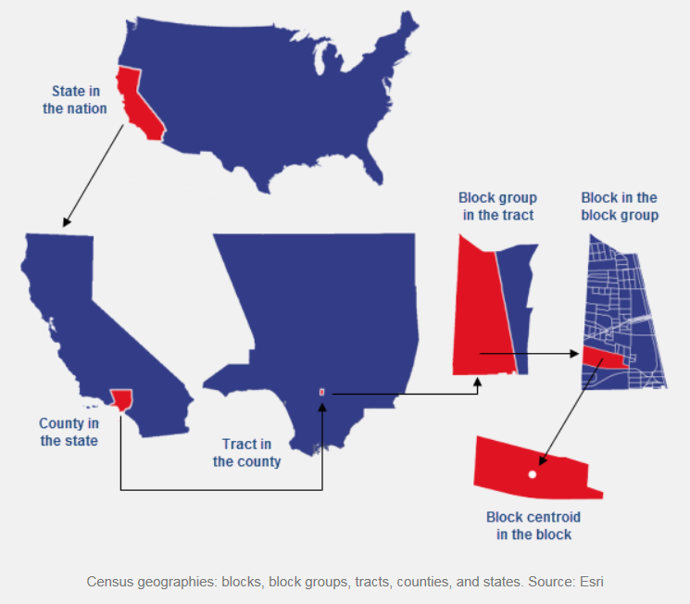
Census Geographies
in a Nutshell
Other Geographies:
-ZCTA; Place; MCD; Congressional District; School District, PUMAs
In NJ:
-County Subdivision=
Municipality

Slide 10
Thresholds for ACS data
PUMAs
Large Cities
County
Congressional District
100,000
ACS 1-year data
(Sept release)
65,000
Census Tract
County
Place/MCD
ZCTA’s

Slide 11
Thresholds for ACS data
PUMAs
Large Cities
County
Congressional District
100,000
ACS 1-year data
(Sept release)
65,000
Census Tract
County
Place/MCD
ZCTA’s
ACS 5-year data
(Dec release)
4,000
Other geographies available – large MOE’s

Slide 12
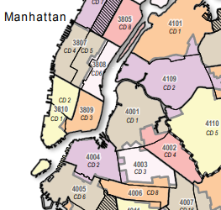
Public-Use Microdata Areas (PUMAs)
Useful for NYC
Defined for the tabulation and dissemination of granular (micro) data
State Data Centers may delineate
Threshold of 100,000
Named & Numbered Areas
Notes:
Public Use Microdata Areas (PUMAs) are decennial census areas that have been defined for the tabulation and dissemination of Public Use Microdata Sample (PUMS) data, American Community Survey (ACS), and ACS period estimates.
State Data Centers (SDCs) in each state, the District of Columbia, and the Commonwealth of Puerto Rico were given the opportunity to delineate PUMAs within their state or statistically equivalent entity.
All PUMAs must nest within states and have a minimum population threshold of 100,000 persons. 2010 PUMAs were built on census tracts, and cover the entirety of the United States, Puerto Rico, Guam and the U.S. Virgin Islands.
***Public Use Microdata Areas (PUMAs) are geographic areas for which the Census Bureau provides selected extracts of raw data from a small sample of census records that are screened to protect confidentiality. These extracts are referred to as public use microdata sample (PUMS) files.
For the 2010 Census, each state, the District of Columbia, Puerto Rico, and some Island Area participants delineated PUMAs for use in presenting PUMS data based on a 5 percent sample of decennial census or American Community Survey data. These areas are required to contain at least 100,000 people. This is different from Census 2000 when two types of PUMAs were defined: a 5 percent PUMA as for 2010 and an additional super-PUMA designed to provide a 1 percent sample. The PUMAs are identified by a five-digit census code unique within state

Slide 13
American Indian Areas/Alaska Native Areas/Hawaiian
Geography Hierarchy
Define your unit of analysis.
Work through the chain.
Nation
ZCTA
Urban Areas
State
Metro- & Micropolitan Areas
Congr. Dist.
County
Urban Growth Area
School District
State Leg. Dist.
Voting District
Tract
Places
(Inc. & CDP)
County Subdivision
(MCD/CCD)
Block Group
Public Use Micro-data Areas (PUMA)
Block*
*Not available ACS

Slide 14
B05003A
Anatomy of a
Table ID

Slide 15
B05003A
Initial character=
Type of Table
B = Base
C = Collapsed
S = Subject
DP = Data Profile
CP = Comparative
Profile
Anatomy of a
Table ID

Slide 16
B05003A
Anatomy of a
Table ID
Next 2 digits, Broad Subject:
01 – Age and Sex
02 – Race
03 – Hispanic Origin
04 – Ancestry
05 – Foreign Born, Citizenship
06 – Place of Birth
07 – Residence 1 Year Ago, Migration
08 – Journey to Work, Commuting
09 – Children, Household Relationship
10 – Grand-parents; -children
11 – Household Type
12 – Marital Status
13 – Fertility
14 – School Enrolment
Up to 29

Slide 17
B05003A
Anatomy of a
Table ID
Next 3 digits
Uniquely i.d.
Topic within
Subject area

Slide 18
B05003A
Anatomy of a
Table ID
Suffix – indicates
Table repeated
for 9 major races.
A=White Alone
B=Black Alone
C=Am Indian
D=Asian Alone
E=Native Hawaiian,etc
F=Some Other Race
G=2 Or More Races
H=White Alone, Not Hisp.
I=Hispanic or Latino

Slide 19
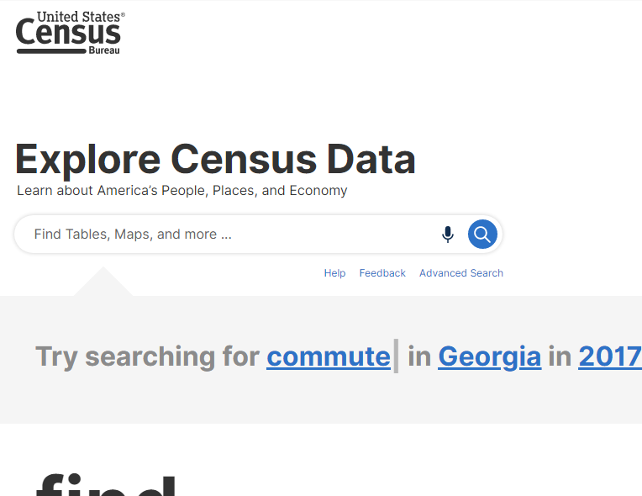
data.census.gov
Aka “Explore Census Data”
URL : data.census.gov
Use Advanced Search
Years back to 2000
Multiple Surveys

Slide 20
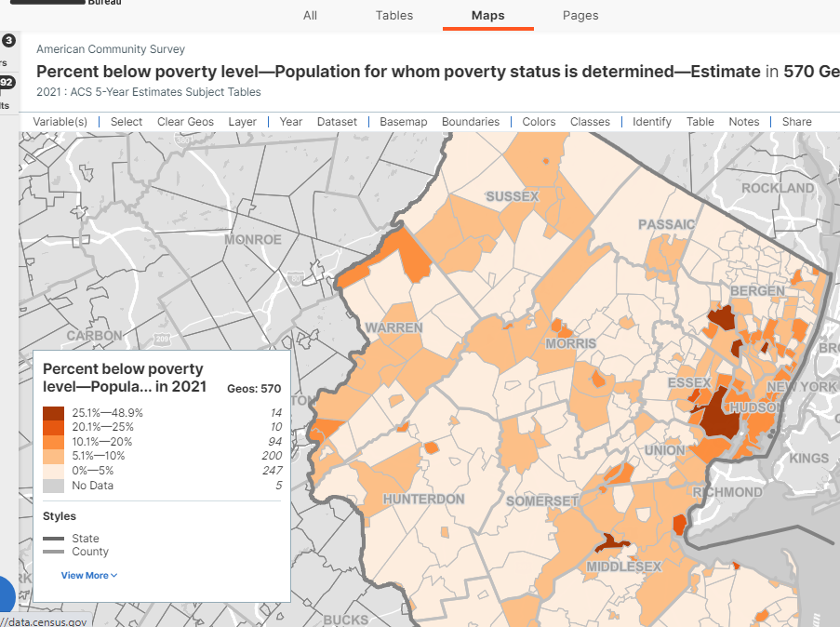
data.census.gov
Aka “Explore Census Data”
URL : data.census.gov
Use Advanced Search
Years back to 2000
Multiple Surveys

Slide 21
Year
Geo
Selec-tion
Survey
Steps to follow:
Looking for Data
Drop-down
Within Geo
Map Selection
But you will have to select the type of data table you want (DP, B, S, etc.)

Slide 22
Year
Geo
Selec-tion
Topic
Steps to follow:
Looking for Data
But you may have to select the survey you need.

Slide 23
You will get all years, but you will still have to select the data table, and potentially the year.
Steps to follow:
Looking for Data
Geo
Selec-tion
Survey

Slide 24
David KRAIKER
david.j.kraiker@census.gov
census.askdata@census.gov
1-844-ASK-DATA
(275-3282)
@uscensusbureau
Subscribe: census.gov/academy
Sites of Interest:
www.census.gov/acs
data.census.gov
www.censusreporter.org

Slide 25
Find the DP Tables for Legislative District 10. (2022)
What percent of people work from home?
What percent of housing units were built before 1939?
What is the average income?
Problem
DP Tables

Slide 26
Look at all Legislative Districts. Search by subject – housing and financial. (2022 – S2503)
Which District has the highest monthly housing costs? (Use the map tool to help you determine).
Problem
Search by Subject Table

Slide 27
Find all the county subdivisions within State Senate District 20.
(use the ‘within’ tool)
Which town has the highest percent of uninsured? (Use the map tool to help you determine).
Problem
Search
“within tool”

