Slide 1

The Legislative Budget Process

Slide 2
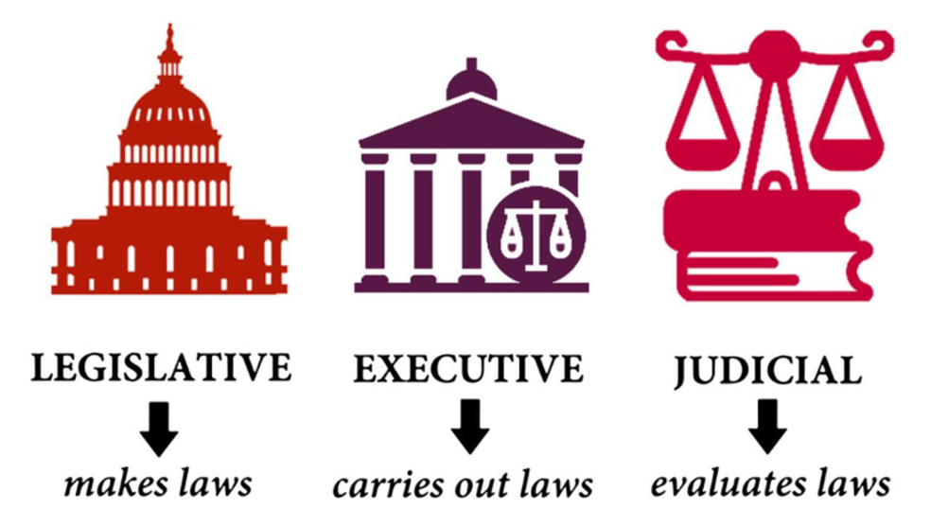
The Branches of Government

Slide 3
Let’s Start at the Very Beginning…
All money matters are reviewed, and legislative proposals are developed by the two fiscal committees
Appropriations Committee
State Budget (spending plan)
Finance, Revenue and Bonding Committee
Revenue Package (taxes and fees)
Bond Package (the State’s “credit card”)

Slide 4
Appropriations Committee
53 Members - 14 Senators/39 Representatives
Subcommittee Structure:
13 Subcommittees, 12 of which review the budget
Organized by Subject Area/Function of Government
Notes:
FRB has two bonding subcommittees – General and Transportation – to review the capital plan

Slide 5
Key Players in the Executive Branch
State Agency personnel
Office of Policy and Management (OPM) Secretary and budget staff
Governor’s staff

Slide 6
Executive Branch Budget Development and Submittal
State Agencies submit Legislative Proposals and Budget Options to OPM by October 1.
OPM reviews Agency requests and submits tentative budget to Governor in mid-November.
Governor presents budget to Legislature in early February

Slide 7
Appropriations Committee Process February
Governor’s budget bill is referred to the Appropriations Committee.
The proposal is analyzed and distributed to legislators and staff.
Appropriations Committee holds Agency Budget Presentations and Public Hearings by subject matter area (Subcommittees).
Drafted (written)
by LCO
Analyzed by OFA

Slide 8
Public Impact on Budget Process
Constituents
Advocacy Organizations
Legislators

Slide 9
Appropriations Committee Process February/March
Subcommittees hold Work Sessions with State Agencies.
Subcommittees formulate budget recommendations to present to the Appropriations Committee Co-Chairs and Ranking Members.

Slide 10
Appropriations Committee Process March
“Subcommittee Reports to the Chairs”
Appropriations Co-Chairs develop the Appropriations Committee Budget.

Slide 11
Appropriations Committee Process March/April
Appropriations Committee reports (JF’s) budget bill to the House of Representatives.
Appropriations Committee reports (JF’s) subject matter and potential implementer bills to the House and Senate by the JF Deadline.

Slide 12
Finance, Revenue and Bonding Committee
51 Members – 13 Senators/38 Representatives
Subcommittee Structure:
General Obligation Bonding Subcommittee
Transportation Bonding Subcommittee
Notes:
FRB has two bonding subcommittees – General and Transportation – to review the capital plan

Slide 13
Finance Committee Process February/March
Committee receives Governor’s revenue bill and bond bill.
Office of Fiscal Analysis provides summaries of the Governor’s proposals to the Co-Chairs and Ranking Members.

Slide 14
Finance Committee Process March
Bonding Subcommittees hear from State Agencies on their capital plans in bond bill.
Bonding Subcommittee members hold internal work sessions to identify bonding priorities.
Finance Committee holds one public hearing on revenue bill and bond bill.

Slide 15
Finance Committee Process April
Bonding Subcommittee Chairs formulate recommendations on bond package and submit to the Finance Committee Co-Chairs.
Co-Chairs make final decisions on what is in revenue and bond packages and discuss with committee members in caucus.
Finance Committee votes (JF’s) revenue bill and bond bill.

Slide 16
Negotiations Budget, Revenue, and Capital Plans
Key Players:
Leadership Staff
Fiscal Chairs
Governor’s Staff
OPM Staff
OFA Staff
Fiscal Committee Administrators

Slide 17
Considerations Limitations on Spending
Spending Cap
Revenue Cap
Volatility Cap
Bonding Cap

Slide 18
Considerations - Priorities
Caucus vs. Governor
Hot Button Issues

Slide 19
Implementation Language
Budget Implementer Negotiations
Leadership Staff
Fiscal Chairs
OPM Staff (Budget and Legal)
Governor’s Staff
OFA Staff
LCO Staff
OLR Staff
Fiscal Committee Administrators

Slide 20
Senate and House Action
Senate and House vote on negotiated bills.
Legislation can be drafted as individual bills or as combined bills.
Capital Plan (bonding bill) is considered as a separate bill.

